Slide 1
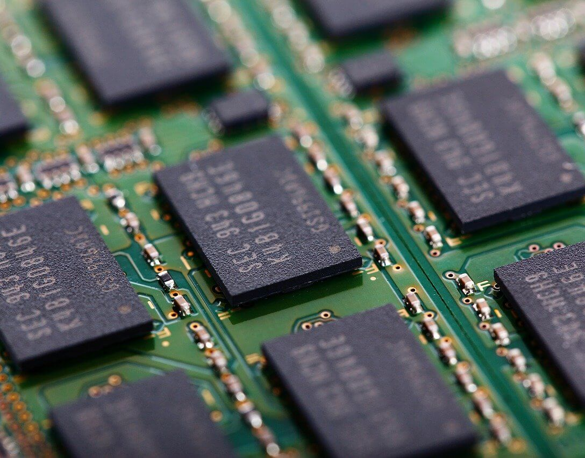
Memory Modules
SIMM, DIMM

Slide 2
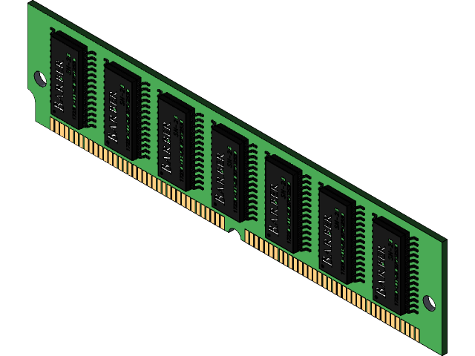
SIMM
It stands for Single Inline Memory Module.
Developed by James J. Parker.
It is mostly used in older computers.
They are installed in pairs.

Slide 3
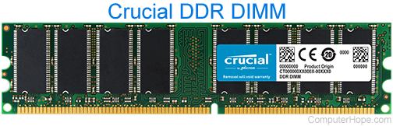
DIMM
It stands for Double Inline Memory Module.
DIMM contains double notch.
It is mostly used in modern computers.
They are installed One at a time.

Slide 4
COMPARISON
SIMM
DIMM
Supports 32 bit channel
Consumes less power.
Common pin configuration is 72
Supports 64 bit channel..
Consumes more power.
Common pin configuration is 168.

Slide 5

THANK YOU!

